Slide 1
Targeted ACT Intervention for Smokers with Bipolar Disorder
Jaimee L. Heffner, PhD
Public Health Sciences, Fred Hutchinson Cancer Research Center
Seattle, WA, USA

Slide 2
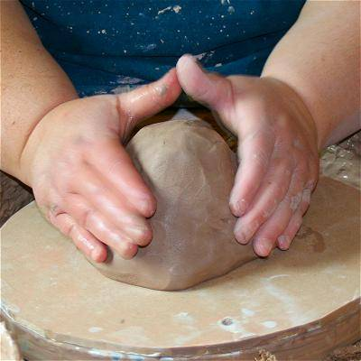
Objectives
Shaping a new intervention
This presentation will cover:
- Treatment rationale
- Overview of the study
- Successes and challenges
You can help us:
Think creatively to address challenges
Learn from your experience with ACT

Slide 3
Prevalence of Smoking
Lasser et al. JAMA 2000; 284: 2606-2610.

Slide 4
Rates of Quitting
Lasser et al. JAMA 2000; 284: 2606-2610.

Slide 5
Why Are Quit Rates So Low?
The usual suspects:
Reasons for relapse in prior quit attempts: stress (74%), craving (26%), family/friend tobacco use (21%)
Barriers to quitting: pleasure of smoking (69%), low self-efficacy for quitting (17%)
Prochaska et al. Bipolar Disord 2011; 13: 466-473.

Slide 6
Why are Quit Rates So Low?
Challenges unique to bipolar disorder (BD):
Half (48%) reported smoking to treat BD symptoms
Barrier to quitting: fear of making BD symptoms worse (35%)
Most (79%) said it was “very important” to be in good mental health when they try to quit, BUT
Of ex-smokers, 64% were in fair or poor mental health when they quit
Prochaska et al. Bipolar Disord 2011; 13: 466-473.

Slide 7
Targeted ACT
Living Free from Tobacco (LiFT) study
Aims: Develop and pilot test a targeted ACT intervention for smokers with bipolar disorder
Targeted ACT process: Acceptance of thoughts, feelings, and sensations that make quitting harder for these smokers

Slide 8
Participant Eligibility
Adults (age 18+)
Bipolar I or II disorder
Daily smokers (10+ cigs/day), motivated to quit
No more than mild current symptoms of BD
Taking stable maintenance medication(s)
No current alcohol or substance dependence

Slide 9
LiFT Therapy Protocol
10 sessions
Individual, face-to-face therapy
30-min duration
Manual-guided

Slide 10
LiFT Session Structure
Values
What is this all about for you?
Acceptance
Defusion
Self as Context
Present Moment
How willing to have these triggers without smoking?
I’m having the thought that..
Words of compassion from future self?
Just noticing while holding an unlit cig
Committed Action
Trigger Tracker
Smoker’s holiday

Slide 11
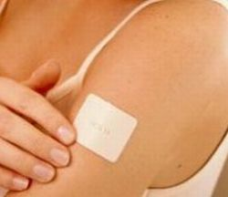
Adjunctive Pharmacotherapy
8 weeks of nicotine patch therapy
Start using on Target Quit Date (after 3rd session)
Tapered dosing:
21mg for 4 wks
14 mg for 2 wks
7 mg for 2 wks

Slide 12
Planned Outcomes
Feasibility/acceptability
Recruitment and retention
Participant satisfaction
Smoking cessation
Process of change
Acceptance (Avoidance and Inflexibility Scale)

Slide 13
Recruitment
Mailed study invitation and called (n=147)
Screened by phone (n=42)
Screened in person (n=5)
Enrolled in study (n=3)

Slide 15
Defusion
People are blown away when I say, ‘You’re having the thought, you don’t have to act on it.’
- Ms. C

Slide 16
Present Moment
If I feel like I’m getting upset, I think about what my body’s feeling—notice my body touching the chair—it makes me feel like I’m in my body more.
- Ms. C

Slide 17
Values
I haven’t felt this free in 5-6 years. I’m thinking about going back to school. I’m starting to feel comfortable again. I really do know what I want, even though I don’t acknowledge it.
- Ms. B

Slide 18
Acceptance
How willing am I to be uncomfortable? I think about that question, like…OK, you’re uncomfortable. Is that really so awful? What was most important in this was making the decision that I’d rather be uncomfortable than continue to smoke.
- Ms. C

Slide 19
ACT vs. Traditional CBT
I never thought to just learn how to sit with [discomfort], be comfortable with it, let it pass. That’s totally different than distracting myself. And when distraction didn’t work, that was proof that I had to smoke. - Ms. C

Slide 20
Generalizing ACT Skills
Willingness to be uncomfortable…that applies to other feelings like anxiety. I don’t have to let this feeling control my actions, and it’s OK that I feel like this, and eventually I won’t feel like this anymore.
- Ms. C

Slide 21
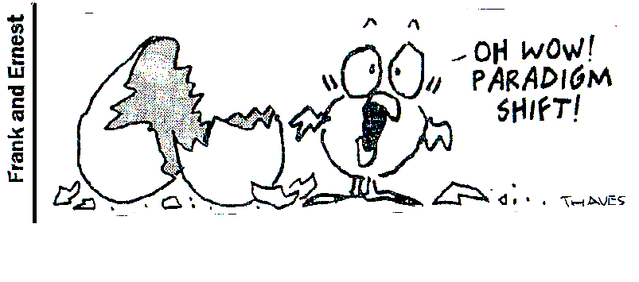

Slide 22
The Case of Mr. Q
Mr. Q:
28 years old
Bipolar I disorder, first manic episode at age 17
Still experiencing problems with attention, anxiety, impulsivity

Slide 23
The Case of Mr. Q
Outcome:
Completed study and 1-mo. follow-up
Low adherence: 5/10 sessions attended, no patch
Little change, if any, in smoking
Planned to use snus and electronic cigarettes, reduce to quit

Slide 24
The Case of Mr. Q
Progress in sessions:
Identified values guiding quitting:
Compassion, loving his family and partner, contributing (at work), health
Noticed feelings, thoughts, and sensations that trigger smoking

Slide 25
The Case of Mr. Q
Self-described challenges:
“Why throw gasoline on a fire?”
Side effects of meds, “needs” cigarette to wake up
Observed challenges:
“People with bipolar disorder…”
Highly impulsive
“I need to figure out why I smoke so I can quit”

Slide 26
Conclusions

Slide 27
Acknowledgements
Primary mentor:
Jonathan Bricker, PhD
Advisory team:
Robert Anthenelli, MD
Thomas Brandon, PhD
Melissa DelBello, MD
Paul Horn, PhD
Jennifer McClure, PhD
David Miklowitz, PhD
Christi Patten, PhD
Giao Tran, PhD
Gregory Simon, PhD
Stephen Strakowski, MD
Tobacco & Health Behavior Science Research Group:
Katrina Akioka
Madelon Bolling, PhD
Helen Jones
Jessica Harris, MA
Laina Mercer, MS
Emily Whitish, MA
Garret Zieve
Funding:
US National Institutes of Health, National Institute on Drug Abuse (NIDA grant #K23DA026517 to J. Heffner)
Fred Hutchinson Cancer Research Center

Slide 28
Thanks for Helping Us Create!

